Slide 1
BREADTH FIRST SEARCH

Slide 2
What is BFS ?
Breadth-first search (BFS) is an algorithm for traversing or searching tree or graph data structures.In BFS you start traversing from a selected node (source or starting node) and traverse the graph layerwise thus exploring the neighbour nodes (nodes which are directly connected to source node). You must then move towards the next-level neighbour nodes.
As the name BFS suggests, you are required to traverse the graph breadthwise as follows:
First move horizontally and visit all the nodes of the current layer
Move to the next layer
The BFS uses a FIFO queue
The time complexity of BFS is O (V + E), where V is the number of nodes and E is the number of edges.

Slide 3
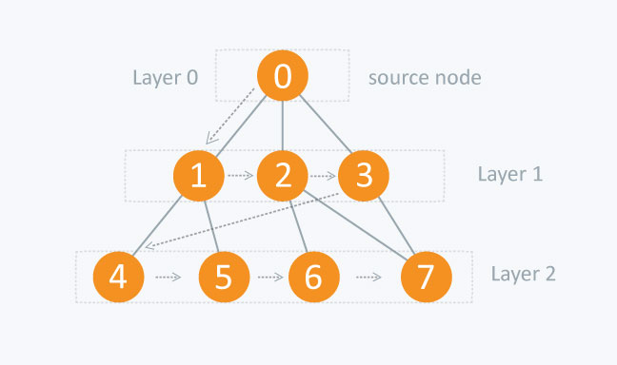

Slide 4
ADVANTAGES--
If Solution exists BFS will definitely find it
If 2 solutions exist the shortest one is found first
Never get trapped in unwanted nodes without the solution
Finds the closest goal in the least time
DISADVANTAGES-
Each level of nodes are stored before creating the next one, hence it uses more memory
If the solution is far away from the root, BFS will consume more time

Slide 5
APPLICATION.
Finding Shortest Path.
Checking graph with bipertiteness.
Copying cheiney's Algorithm.

Slide 6
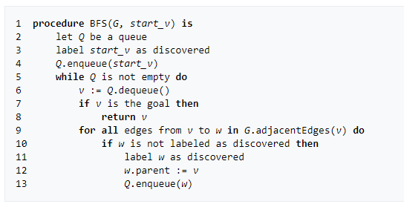
PSEUDO_CODE

Slide 7
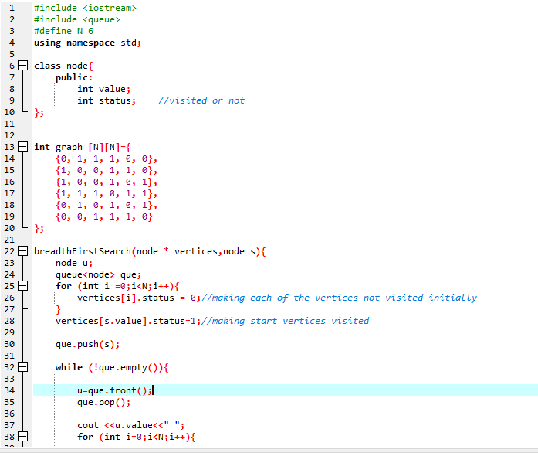
CODE

Slide 8
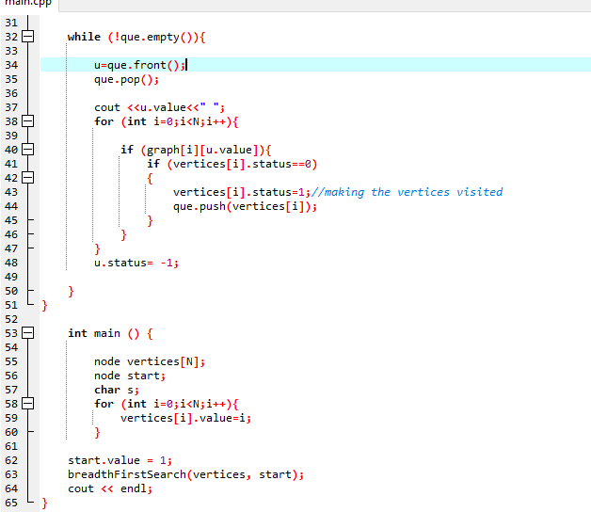

Slide 9
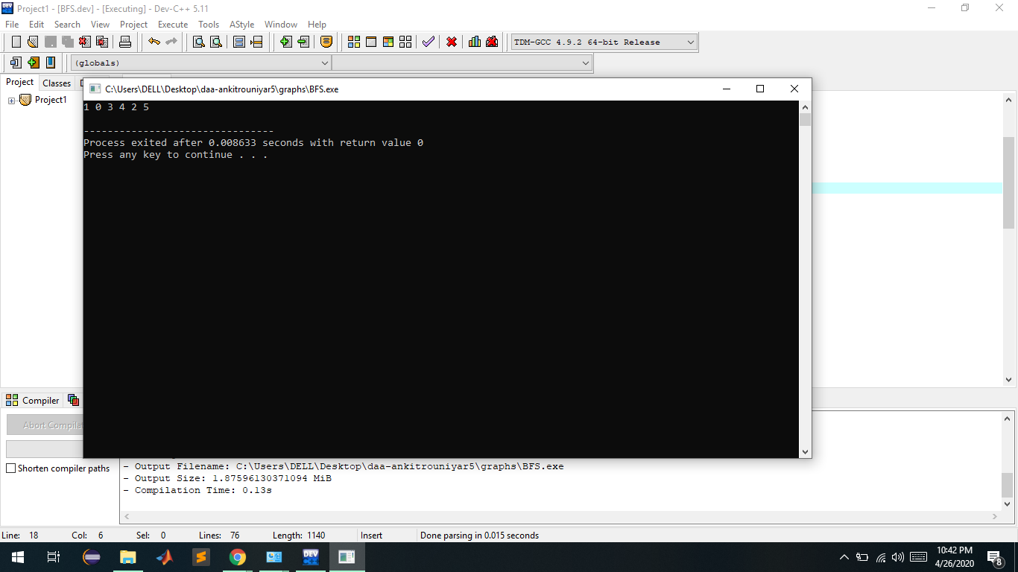
OUTPUT

